Slide 1





INTRODUCTION
1
Project Domain:
Internet Of Things & Web Development
2
Project Sector:
Smart Agriculture
Topic:
3
Smart Irrigation System
Subject:
4
Mini Project (ITUDPV1)
Institution:
SOS Engineering and Technology GGV-(A Central University ) Bilaspur, Chhattisgarh
5
Mentor:
Dr. Amit Kumar Khaskalam Sir
6
01

Slide 2

WHY ARE WE SOLVING?
Agriculture uses over 70% of the world's freshwater.
Yet, most farmers rely on guesswork for irrigation, resulting in:
Water wastage
Crop stress or damage
Reduced productivity
Because there’s a critical lack of data-driven irrigation systems.
We aim to:
Conserve water resources
Empower farmers with smart, actionable insights
Contribute to sustainable agriculture
To develop an affordable, real-time smart irrigation solution.
02

Slide 3

PROJECT OVERVIEW
The Smart Agriculture Predictive Irrigation System is an IoT solution that seeks to optimize water usage with a promise of maximum crop yield in drought-sensitive farming regions. It merges real-time data from soil moisture sensors, weather APIs, and water requirements specific to crops into one channel. Display on web application.
⦁ Sensors are used to collect soil moisture data.
⦁ Weather API to get forecast information.
⦁ Check irrigation schedules.
⦁ Creating a web application that will provide
information to the user.
Learn More
03

Slide 4
CORE FEATURES
1. Real-Time Soil Moisture Monitoring
Continuously tracks soil moisture levels using sensors.
Sends live data to a dashboard or cloud server.
2. Automated Irrigation Control
Automatically turns ON/OFF the water pump based on moisture levels and weather conditions.
Adjusts irrigation automatically based on weather forecasts (e.g., delays watering if rain is expected)
3.Web dashboard
User-friendly interface to view live data, analytics.
4.Low power consumption.
Learn More
03

Slide 5
TECH STACK
Hardware:
ESP8266 (NodeMCU)
Soil Moisture Sensor
Power Supply (5v Battery)
Relay module
Submersibe Pump
Web Development:
HTML, CSS
JAVASCRIPT
CHART.JS
Software:
Firebase(cloud)
Arduino IDE
04

Slide 6


SYSTEM ACHIETECTURE
Website
Field
Moisture
condition
Weather API
Microcontroller
All condition true
Irrigation time
Start irrigation
Process All condition
Firebase
05

Slide 7
HARDWARE ARCHIETECTURE
Hardware Requirements:
⦁ Micro Controller : ESP8266 Node MCU
⦁ Soil Moisture Sensor
⦁ 5v Relay Module
02
⦁ Submersible Pump
⦁ 5V Power Supply
03
⦁ Jumper Wires, Resistors, Transistors, etc.
06

Slide 8
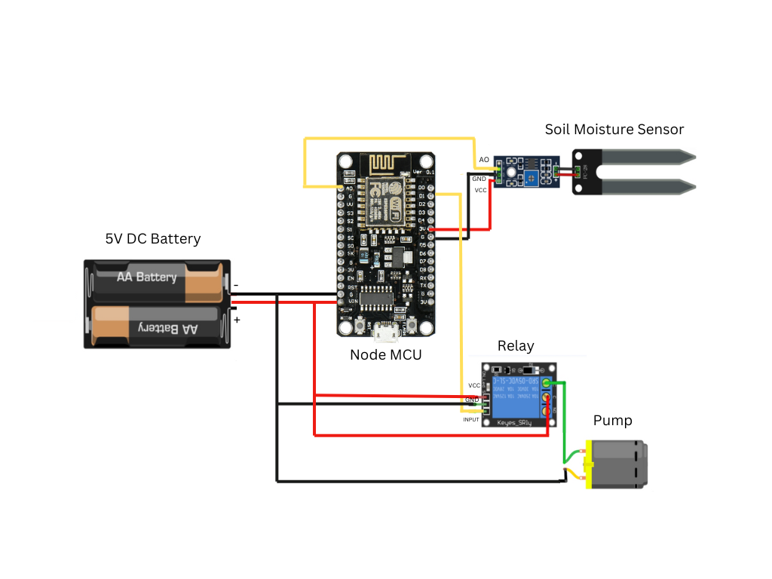
CONNECTION DIAGRAM
Analog pin
06

Slide 9
LOGIC
Start
Connect to WiFi
Collect sensor and precipitation data
Check if chances of precipitation is lower
Check if sensor values are lower
YES
YES
Pump Switch : ON
NO
NO
Pump Switch : OFF
06

Slide 10
LITERATURE OVERVIEW
The IoT is very useful in various fields including Agriculture by enabling real world interaction .
IoT technologies such as sensors, communication systems and data analysis transformed conventional farming into smart agriculture.
Its potential is high but it faces major challanges, as slection of appropriate sensors , data analysis need advanced algorithms.
IOT is expected to drive smart agriculture with the global market projected to grow to 3.39 billion dollor by 2030.
07

Slide 11


THANK YOU
10

